Slide 1
Body Organisation

Slide 2
Curriculum Point
The body has a hierarchical structural organisation of cells, tissues, organs and systems; the functions of the systems are related to life processes

Slide 3
The human body is organised at different levels, starting with the cell and ending with the entire organism. At each higher level of organisation, there is a greater degree of complexity.

Slide 4
Cells
Basic unit of structure and function in the human body as well as all living things.
Each cell carries out basic life processes that allow the body to survive, with many specialised cells (e.g. muscle, nerve, skin).

Slide 5
Tissues
A tissue is a group of connected cells that have a similar function.
There are four basic types of human tissues
  Epithelial: Epithelial tissues are thin tissues that cover all the exposed surfaces of the body. They form the external skin, the inner lining of the mouth, digestive tract, secretory glands, the lining of hollow parts of every organ such as the heart, lungs, eyes, ears, the urogenital tract, as well as the ventricular system of the brain and central canals of the spinal cord.

Slide 6
  Muscle: is a specialized tissue found in animals which functions by contracting, thereby applying forces to different parts of the body. Muscle tissue consists of fibres of muscle cells connected together in sheets and fibres. Together these sheets and fibres and known as muscles, and control the movements of an organisms as well as many other contractile functions.
  Nervous: Nervous tissue is the term for groups of organized cells in the nervous system, which is the organ system that controls the body’s movements, sends and carries signals to and from the different parts of the body, and has a role in controlling bodily functions such as digestion.
  Connective: a tissue, usually of mesoblastic origin, that connects, supports, or surrounds other tissues, organs, etc.

Slide 7
https://www.youtube.com/watch?v=O0ZvbPak4ck

Slide 8
Organs and Organ Systems
An organ is a structure that consists of two or more types of tissues that work together to do the same job. Examples of human organs include the brain, heart, lungs, skin and kidneys.
Human organs are organised into organ systems (a group of organs that work together to carry out a complex overall function).

Slide 9
Body Systems
Our bodies consist of a number of biological systems that carry out specific functions necessary for everyday living.
The job of the circulatory system is to move blood, nutrients, oxygen, carbon dioxide, and hormones, around the body. It consists of the heart, blood, blood vessels, arteries and veins.

Slide 10
The digestive system consists of a series of connected organs that together, allow the body to break down and absorb food, and remove waste.
The endocrine system consists of eight major glands that secrete hormones into the blood. These hormones, in turn, travel to different tissues and regulate various bodily functions, such as metabolism, growth and sexual function.

Slide 11
The immune system is the body's defense against bacteria, viruses and other pathogens that may be harmful. It includes lymph nodes, the spleen, bone marrow, lymphocytes (including B-cells and T-cells), the thymus and leukocytes, which are white blood cells.
The lymphatic system includes lymph nodes, lymph ducts and lymph vessels, and also plays a role in the body's defenses. Its main job is to make is to make and move lymph, a clear fluid that contains white blood cells, which help the body fight infection.

Slide 12
The nervous system controls both voluntary action (like conscious movement) and involuntary actions (like breathing), and sends signals to different parts of the body.
The body's muscular system consists of about 650 muscles that aid in movement, blood flow and other bodily functions. There are three types of muscle: skeletal muscle which is connected to bone and helps with voluntary movement, smooth muscle which is found inside organs and helps to move substances through organs, and cardiac muscle which is found in the heart and helps pump blood.

Slide 13
The reproductive system allows humans to reproduce. The male reproductive system includes the penis and the testes, which produce sperm. The female reproductive system consists of the vagina, the uterus and the ovaries, which produce eggs. During conception, a sperm cell fuses with an egg cell, which creates a fertilized egg that implants and grows in the uterus.
Our bodies are supported by the skeletal system, which consists of 206 bones that are connected by tendons, ligaments and cartilage. The skeleton not only helps us move, but it's also involved in the production of blood cells and the storage of calcium. The teeth are also part of the skeletal system.

Slide 14
The respiratory system allows us to take in vital oxygen and expel carbon dioxide in a process we call breathing.
The urinary system helps eliminate a waste product called urea from the body, which is produced when certain foods are broken down. The whole system includes two kidneys, two ureters, the bladder, two sphincter muscles and the urethra.
The skin, or integumentary system, is the body's largest organ. It protects us from the outside world, and is our first defense against bacteria, viruses and other pathogens. Our skin also helps regulate body temperature and eliminate waste through perspiration. In addition to skin, the integumentary system includes hair and nails.

Slide 15
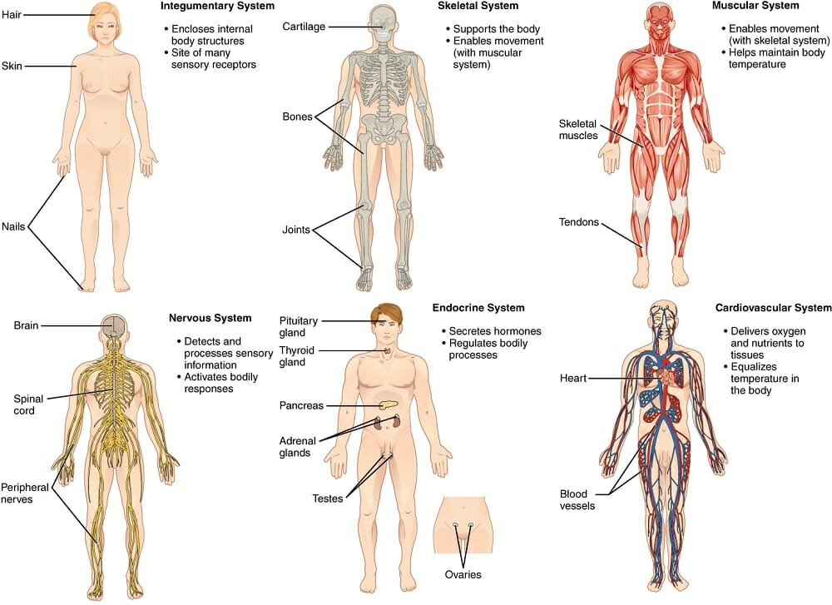

Slide 16
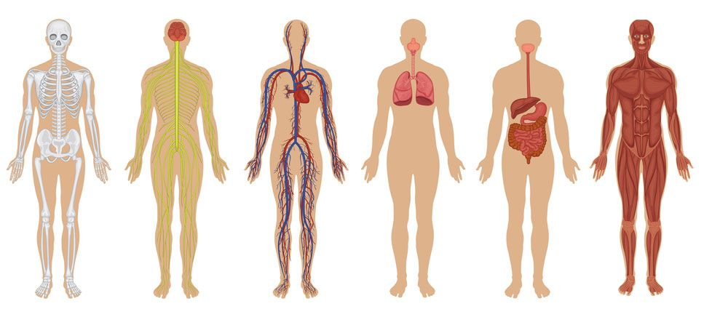

Slide 17
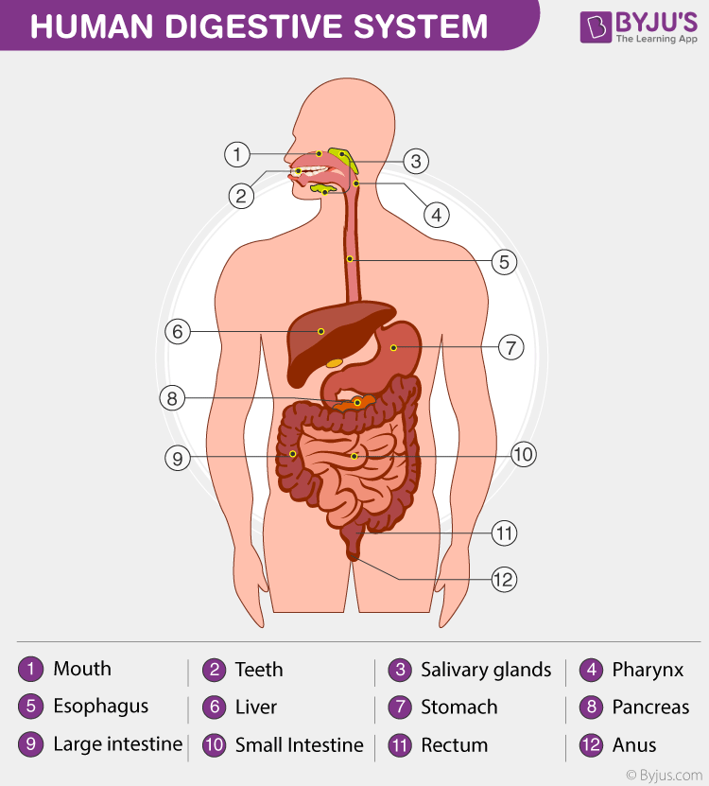

Slide 18
